Slide 1
Carsales website improvement- Overview
Assumption: Total enquiries is selected as desirable conversion. The Daily visit is selected as customers who visited the carsales website.
5% of the website traffic is allocated to the Test and the rest is considered as control group.
The Total Enquiries and Daily Visits during the test is aggregated to Control and Test groups.
A Bayesian MCMC simulation is used to investigate the difference of conversion between control and test group.
The histograms are simulated posterior distribution of conversion rates.

Slide 2
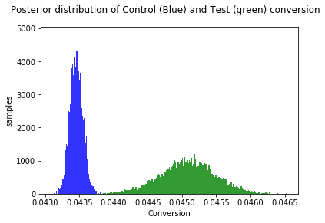
Test result and recommendation
Key test information
Objective: Determine if test version of website increase the conversion to enquiry
      Launch Date: 18th August 2016
      Time in Market: 40 days
      Control visitors: 4421346 visitors
      Control enquiries: 192125 enquiries
      Test visitors: 250864 visitors
      Test enquiries: 11308 enquiries
      Test uptake Significance: 100.00%
      Conversion improvement: 3.75%
      Conversion difference : 0.00161
Recommendation
      Adapt the change (Test).

